Slide 1
HOME SECURITY AUTOMATION AND FIRE ALARM SYSTEM

Slide 2
GROUP MEMBERS:
NIRMAL KUMAR - 21EC30036
PITTA RISHITHA - 21ME10055
ANUNAK ROY - 21EE10017
MADHAVARAPU LAKSHMI JOTSNA - 21MA10029
VAIBHAV JOSHI - 21EC30056

Slide 3
OBJECTIVE OF OUR PROJECT:
We are trying to create a simple and affordable system to increase the security of our homes and protect our homes from sudden fire outbursts.
We are making it simple by using basic GSM technology to receive OTP for unlocking the doors and sending emergency messages during a fire.
Since nowadays everybody is having the basic utility of a regular smartphone so integrating this system into their day-to-day life won’t be a problem.

Slide 4
ADVANTAGES OVER CURRENTLY AVAILABLE SOLUTIONS:
Available solutions are expensive as compared to our model.
Available products are difficult to set up for common people as compared to our model which is quite hassle free.
We have integrated both the security aspects as well as fire alarm together but the market demands to buy separate products for them.
Since we are using a GSM based approach as compared to the WIFI driven products in the market we have an advantage of range. Wire less based products tend to have small ranges.
Many wireless devices use battery which has to be replaced timely. Whereas our model gives you the freedom to choose whether you want an AC or DC source.

Slide 5
SOLUTION TO THE PROBLEM:
FOR SECURITY AND ANTI-THEFT:
We are going to use electronic locks which work on 4-digit code input, this OTP is sent to our smartphones via SMS whenever we want to open the door.
FOR FIRE ALARM:
A simple circuit consisting of a flame sensor that sends a signal when attained a particular reading which can be an indication of a fire outburst. An alarm is added to the circuit which goes off during the same and the message is sent to your smartphone/mobile.

Slide 6
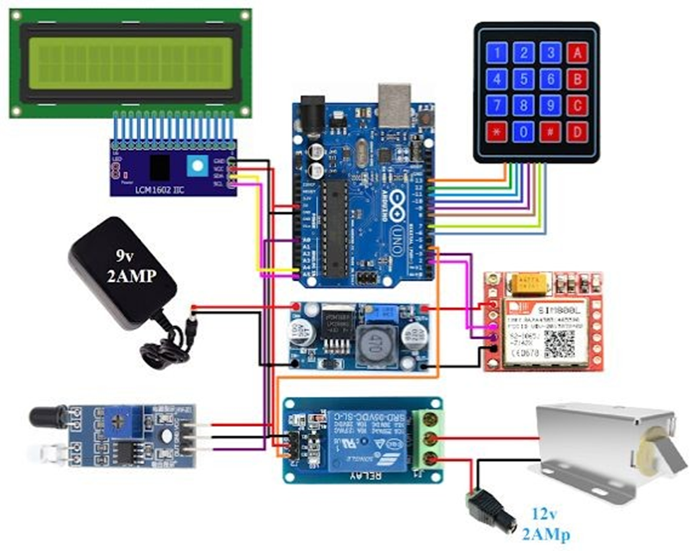
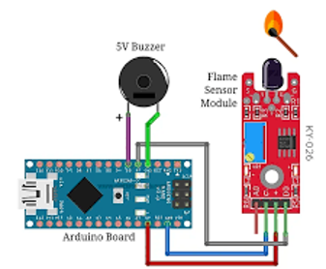
Pictures:

Slide 7
COMPONENTS:
ARDUINO
GSM MODULE
BREADBOARD
SMOKE DETECTOR
JUMPER WIRES
5V1 CHANNEL RELAY MODULE
LM2596 STEP-DOWN MODULE
SOLENOID LOCK
PIEZO BUZZER
TEMPERATURE SENSOR
IR SENSOR
LCD DISPLAY
KEYPAD

Slide 8
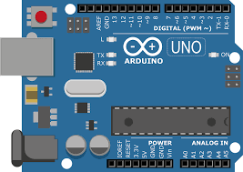
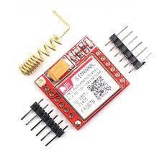
ARDUINO:
Arduino boards are able to read inputs - light on a sensor, a finger on a button, or a Twitter message - and turn it into an output - activating a motor, turning on an LED, publishing something online.
GSM MODULE:
A GSM modem or GSM module is a device that uses GSM mobile telephone technology to provide a wireless data link to a network.

Slide 9
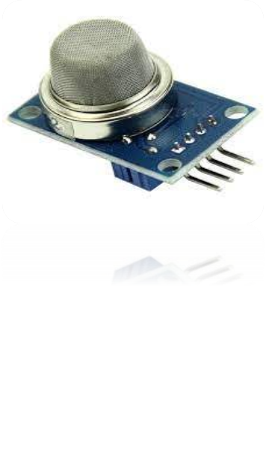
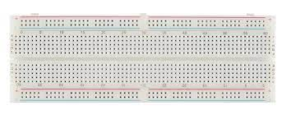
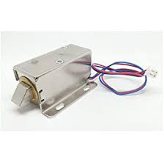
SMOKE DETECTOR:
A smoke alarm stands guard around the clock, and when it first senses smoke, it sounds a shrill alarm
BREAD BOARD:
A breadboard, or protoboard, is a construction base for prototyping of electronics.
SOLENOID LOCK:
It can be used to lock/unlock a cabinet, door, or drawer.

Slide 10

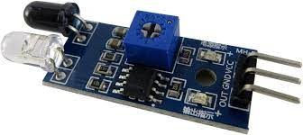
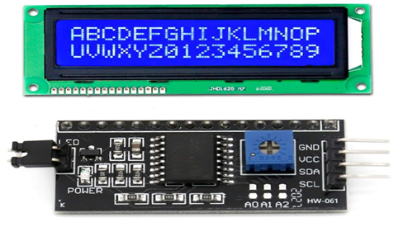
PIEZO BUZZER:
It is basically a tiny speaker that we can
connect directly to an Arduino. We can make
it emit a tone at a particular frequency we set
in response to a given input.
IR SENSOR:
The Passive Infrared (PIR) sensor is used to
detect the presence of a human.
LCD 16X2 + I2C MODULE:
An LCD screen is an electronic display module that uses liquid crystal to produce a visible image.

Slide 11
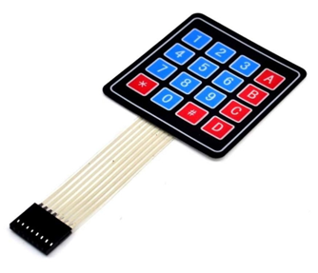
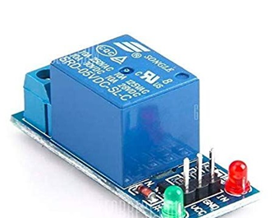
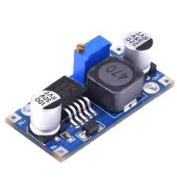
KEYPAD:
Key pad is used to enter OTP.
5V1 CHANNEL RELAY MODULE:
A 5V relay is an automatic switch that is commonly
used in an automatic control circuit and to control a
high-current using a low-current signal.
LM2596 STEP-DOWN MODULE:
LM2596 is a voltage regulator mainly used step down the voltage or to drive load under 3A.

Slide 12
COMPONENT NAME | QUANTITY | PRICE(Rs)
ARDUINO | 1 | 1000
GSM MODULE | 1 | 480
BREADBOARD | 1 | 230
LM2596 STEP-DOWN MODULE | 1 | 90
SMOKE DETECTOR | 1
JUMPER WIRES | - | -
5V1 Channel Relay Module | 1 | 150
SOLENOID LOCK | 1 | 475
PIEZO BUZZER | 1 | 100
IR SENSOR | 1 | 170
TEMPERATURE SENSOR | 1
LCD DISPLAY | 1 | 300
KEYPAD | 1 | 200
TOTAL COST |  | 3000-4000

Slide 13
SOFTWARES:
ARDUINO IDE
FRITZING
TINKER CAD

Slide 14

CONTRIBUTIONS by team members :

Slide 15
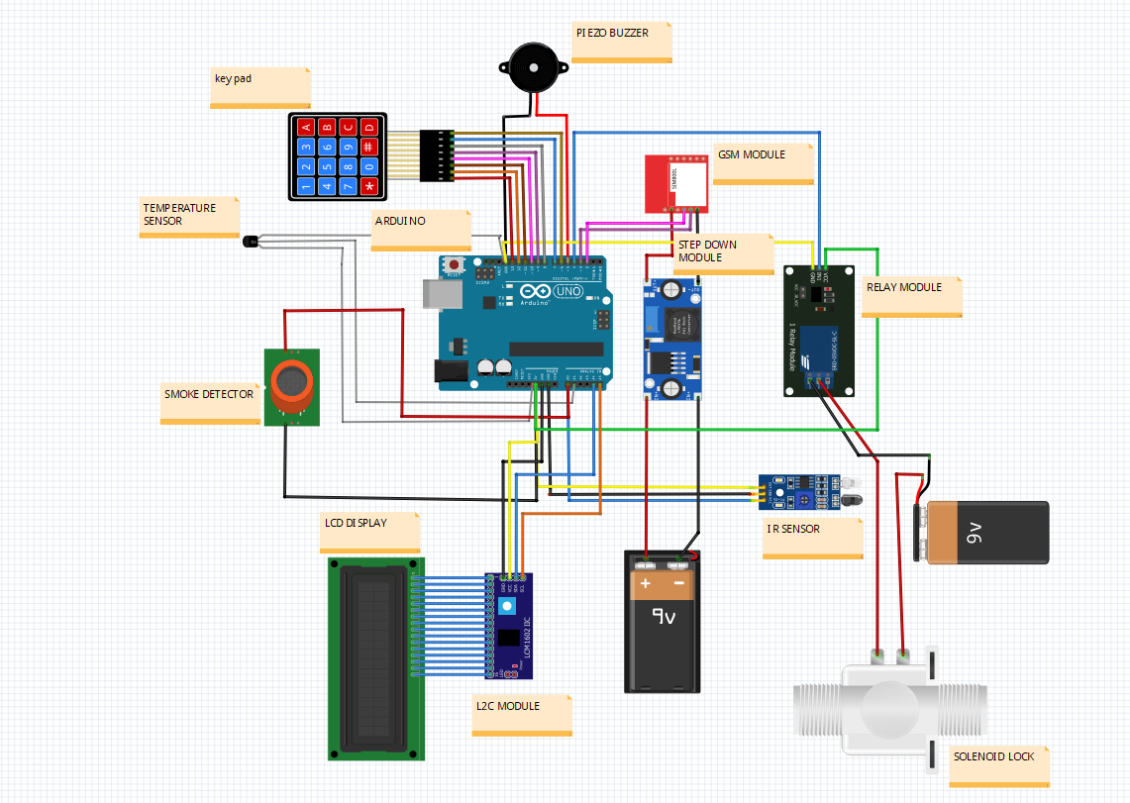
Circuit diagram

Slide 16
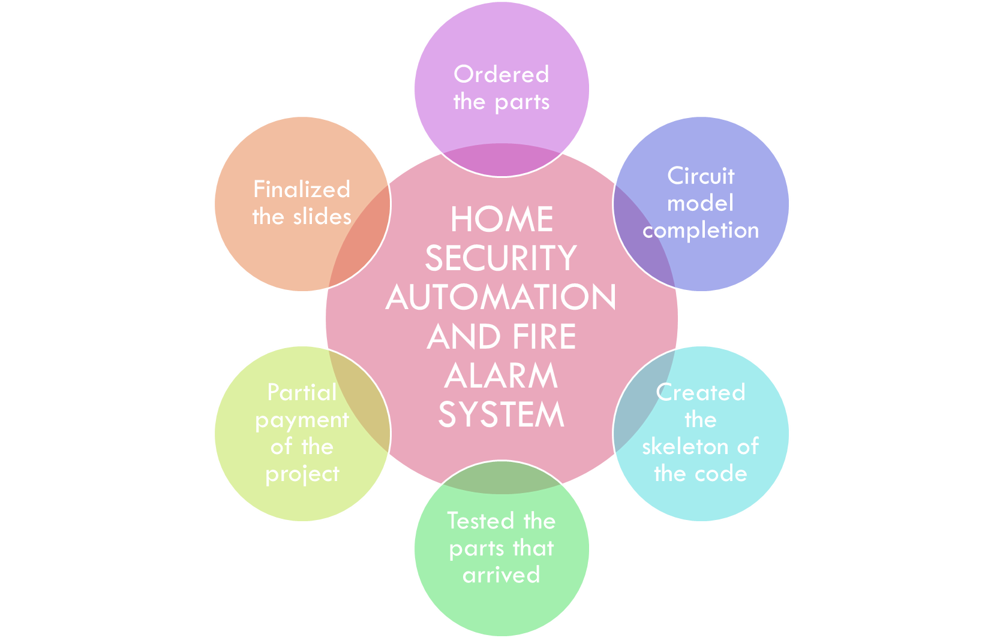

Slide 17
CONCLUSIONS :
Fire detection and home security are two quite important things and our project unifies their working into a simple solution.
The problem of sudden fire outburst at our houses is not a new problem and neither is it going to stop in the near future due to various factors which can provoke fire like electrical equipment, gas stoves and cylinders.
Same goes with home security, thefts and robberies are not going to stop in the upcoming future as the rate of unemployment is increasing day by day, so our OTP door lock system provides a healthy solution to it.
By doing this project we all got to learn a lot, ranging from daily life problem to problem-solving to teamwork, workload distribution and cooperation among team members.

Slide 18
FUTURE SCOPE:
We can create a mechanism to keep the door unlock for maximum of 2 minutes until no body is in the proximity of the door and then it will lock to prevent entering OTP multiple number of times.
A system can be added which detects the family member entering the room and then the OTP would be sent to their device in particular, this will help in preventing confusion and unnecessary OTP’s.
We can add water sprinkler so that when fire is detected it automatically sprinkles water.

